Slide 1

STACK AND MACROS IN 8085
(UNIT-3)
(SUB: Microprocessor and Interfaces)
PREPARED BY:
ER. MOHIT MISHRA
ASSOCIATE PROFESSOR
COMPUTER SCIENCE DEPARTMENT

Slide 2
TOPIC COVERED
WHAT IS STACK?
PUSH AND POP INSTRUCTION
OPERATION OF THE STACK BY PUSH AND POP INSTRUCTION
LOOPING AND COUNTING TECHNIQUES
DESIGING OF MACRO
MACRO LIBRARIES

Slide 3
WHAT IS STACK?
The stack is a group of memory location in the R/W memory (RAM) that is used for temporary storage of data during the execution of a program.
Address of the stack is stored into the stack pointer register.

Slide 4
PUSH AND POP INSTRUCTIONS
The 8085 provide two instructions PUSH & POP for
storing information on the stack and reading it back.
• Data in the register pairs stored on the stack by using the instruction PUSH.
• Data is read from the stack by using the instruction POP.
• PUSH & POP both instruction works with register pairs only.
• The storage and retrieval of the content of registers on the stack fallows the LIFO(Last-In-First-Out) sequence.

Slide 5
OPERATION OF THE STACK BY PUSH AND POP INSTRUCTION
LXI SP, 2099H ; this instruction define stack
LXI H, 42F2H ; this instruction store 42F2 in to the HL pair
PUSH H ; store HL pair on to the stack
2010 POP H ; store data from top of the stack to HL pair

Slide 6
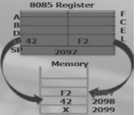
For PUSH H:
The stack pointer is decremented by one to 2098H, and the contents of the h register are copied to memory location 2098H.
The stack pointer register is again decremented by one to 2097H,and the contents of the L register are copied to memory location 2097H.
The contents of the register pair HL are not destroyed.

Slide 7
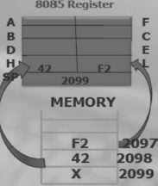
For POP H:
The stack pointer is decremented by one to 2098H, and the contents of the h register are copied to memory location 2098H.
The stack pointer register is again decremented by one to 2097H,and the contents of the L register are copied to memory location 2097H.
The contents of the register pair HL are not destroyed.

Slide 8
LOOPING AND COUNTING TECHNIQUES
The Programming Technique used to instruct the microprocessor to repeat task is called looping. This process is accomplished by using jump instructions.
A loop can be classified into two groups:
Continuous loop- repeats a task continuously
Conditional loop-repeats a task until certain data condition are met

Slide 9
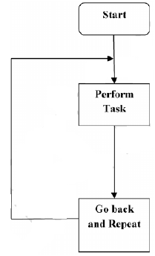
CONTINUOUS LOOP(TIMING DELAY LOOP)
A continuous loop is set up by using the unconditional jump Instruction shown in the flowchart.
A program with Continuous loop does not stop repeating the tasks until the system is reset.

Slide 10
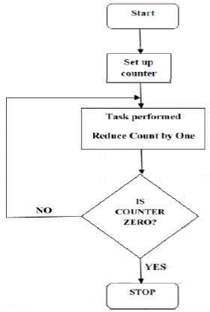
CONDITIONAL LOOP(COUNTER LOOP)
A Conditional loop is setup by the conditional jump instructions.
These instructions Check flags (zero, carry, etc.) and repeat the specified task if the conditions are satisfied.
These loops usually include counting and indexing. Conditional loop is shown by the Flowchart as follow.
The Flowchart is translated into the program as follows:
Counter is setup by loading an appropriate
count in a register.
Counting is performed by either incrementing
or decrementing the counter.
Loop is set up by a conditional jump instruction.
4. End of counting is indicated by a flag.

Slide 11
MACRO
A macro is a group of repetitive instructions in a program which are codified only once and can be used as many times as necessary.
At the moment when the macro is executed, each parameter is substituted by the name or value specified at the time of the call.
We can say that a procedure is an extension of a determined program, while the macro is a module with specific functions which can be used by different programs.

Slide 12
DESIGING OF MACRO
Parts which make a macro are:
i. Declaration of the macro.
ii. Code of the macro.
iii. Macro termination directive

Slide 13
DESIGING OF MACRO
Declaration of the macro: Name Of Macro MACRO [parameter1, parameter2...]
Even though we have the functionality of the parameters it is possible to create a macro which does not need them.
The directive for the termination of the macro is: ENDM

Slide 14
DESIGING OF MACRO
Declaration of the macro: Name Of Macro MACRO [parameter1, parameter2...]
Even though we have the functionality of the parameters it is possible to create a macro which does not need them.
The directive for the termination of the macro is: ENDM

Slide 15
MACRO LIBRARIES
One of the facilities that the use of macros offers is the creation of libraries, which are groups of macros which can be included in a program from a different file.
The creation of these libraries is very simple, we only have to write a file with all the macros which will be needed and save it as a text file.
To call these macros it is only necessary to use the following instruction Include Name Of The File, on the part of our program where we would normally write the macros, this is, at the beginning of our program, before the declaration of the memory model.

